Slide 1
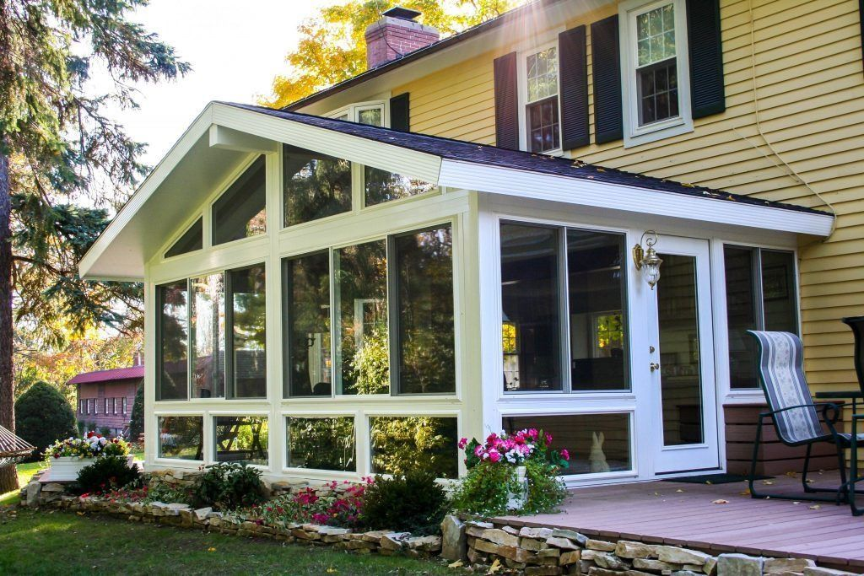
Kick-off meeting
Project: Sun room on personal home
Organization: Kelly Family
Sponsor Name: Allyson Kelly

Slide 2
Meeting Attendees
Owner: Allyson Kelly
Project Manager: John M. Anager
Architect: Susie Designsalot
Electrician: Tom Electricity
Plumber: Bob ThePlumber
Carpenter Lead: Mike Hammerman
Homeowners Association President: Randy Drumm
King County Inspector: Peter S. Clouseau
Neighbors
Friends

Slide 3
Meeting Agenda
Get contact information (phone numbers, emails)
Review the architectural drawings
Go over the project plan in MS project and review the schedule
Confirm availability during the scheduled times
Discuss potential risks
Questions?

Slide 4
Project Description
Build a sun room on the south east side of the kelly home. The room will match the existing architecture of the home. There will be many windows and a vaulted ceiling with skylights. The size is approximately 12 x 30 feet.

Slide 5
Business case
EXECUTIVE SUMMARY
This plan outlines a project to build a sun room on the south east side of the Kelly home. The design will match the existing homes architecture and it’s current paint and siding. The added windows will enable amazing views into the long section of landscape with views of evergreen trees, flowers and grass. Also, the sunrise will shine into the large windows. Inside the room will be a gas stove to warm the room on cool days. In the summer, the room will be warm from the sun but also feature air-conditioning from the installed heating and cooling ducts.

Slide 6
Business case
PROBLEM TO SOLVE
Currently, there is a small window on the east side of the Kelly home. The early sun shines in but in small amounts. There is also a huge side yard with trees and flowers to view. The only way to experience this view is to go outside and sit in a lawn chair. This might work in the 3 summer months but the other 9 months will not be feasible due to poor weather. The proposed project is to add a “Sun Room” to the side of the house. The entrance to the new room will be from the main home and will contain double doors that can be opened constantly or closed as needed.

Slide 7
Business case
CUSTOMER(S)
The ultimate users will be the Kelly family. The neighbors could also gain by having parties at the Kelly home to enjoy the room. Also, relatives will enjoy the new views and expanded house.

Slide 8
Business case
BENEFIT/VALUE
The benefits with be:
• Increased sunlight into the house in the morning. This will allow the homeowners to enjoy a cup of coffee watching the sunrise.
• Warmth of the sun will save on energy bills for the homeowners.
• Access to the side yard by installing a double door from the house and then a door to the yard. This will allow the dog and kids to play outside and the homeowners can keep an eye on them.
• Extra room for entertainment. A TV monitor can be placed in the room for evening movies.
• Increasing the value of the home. This will affect the resale value in the future.
• A gas fireplace will be installed that works in the adjacent room and in the sun room.

Slide 9
Business case
OUTCOMES
• The value of the house will increase.
• The light coming in from the south east side will be increased.
• New access to the side yard.
• More viewing of the side yard.
• Better options to contain entertainment sound or noises by closing the double doors when watching a movie or talking with friends.

Slide 10
Business case
STRATEGIC ALIGNMENT
• Organizational Objectives/Performance Measures
o Complete the project in 3 months. Each Resource will be available when requested. The homeowners spend a lot of time in their house and could benefit from increased usage from the new room.
• Financial Benefit
o The Return on Investment (ROI) will be more that the cost of the project. Resale will be faster with such a view and usage of the new room.
• Reduction of Risk
o A good architectural drawing is completed and validated by the carpenter and homeowners. Each party will sign off on the design.
o A good estimate of materials is needed due to rising costs of materials. Alternative materials may be considered such as particle board beams and flooring.
o Make sure all permits and approvals are in place before construction begins.
o Contractors such as electricians, plumbers, carpenters and roofers are lined up to avoid delays. They all need to be licensed and bonded. Validate the credentials and get referrals.
o Designs such as colors of paint, types of windows and furnishes are decided on by the homeowners before if possible or during the consultation with the carpenter.
• Impact on the Organization’s Community
o The Homeowners association will need to be contacted and presented with plans of the new edition.
o The county will require a permit before construction can begin.
o A sensitive land use permit may be required.
o The “Before you dig” hot line will need to be called to check for under ground pipes and wires.

Slide 11
Business case
RESOURCE REQUIREMENTS
Name/Title | Role | Primary Responsibilities
Lead Designer | Architect for building plans and interior design | Draw an architectural design to match the house and neighborhood
Lead Carpenter | Implement the design from the architect | Build the room, double door to house, door to outside, frame walls, floors, ceiling, install windows. Create foundation. Create roof.
Master Electrician | Coordinated the wiring | Lead the wiring effort and hire other resources as needed. Wire outlets and install lights.
Lead Plumber | Coordinated the plumbing | Lead the plumbing effort and hire other resources as needed. Connect gas lines to new room. Install gas stove and ducts.
Homeowners | Work on tasks that can save money | Paint, clear debris, misc furnishings, other?
Before you dig team | Check for pipes or wires | Paint on the ground the findings
King County Inspector | Inspect project | Validation that every thing is up to code.
Concrete Company | Pour concrete | Finish foundation

Slide 12
Business case
COST BENEFIT ANALYSIS
Action (Identify if cost or savings) | Description | Amount | Funding Source
Cost | Hire Architect to create a blue print | 5000 | Savings account
Cost | Labor for Carpenter to build structure | 20000 | Savings account
Cost | Labor for Electrician | 3000 | Savings account
Cost | Labor for Plumber | 2000 | Savings account
 | Material costs:
Cost | Electrical parts, outlets, lights | 1000 | Savings account
Cost | Foundation - concrete | 1000 | Savings account
Cost | Connect gas line and heating ducts | 1500 | Savings account
Cost | Gas stove incl installation | 3000 | Savings account
Cost | Paint for interior/exterior | 500 | Savings account
Cost | Siding | 1000 | Savings account
Cost | Roof | 2000 | Savings account
Cost | lumber for walls, floor, ceiling | 3000 | Savings account
Cost | Doors | 2000 | Savings account
Cost | Windows | 3000 | Savings account
Cost | Flooring | 1000 | Savings account
Cost | Misc materials | 2000 | Savings account
Cost | Permits/Approvals | 1000 | Savings account
Savings | Homeowner will clear the area of debris where the foundation is going to sit. | 0 | NA
Savings | Homeowner will paint interior/exterior | 0 | NA
Savings | Homeowner will install furnishing such as window blinds | 0 | NA
Total |  | 51,500

Slide 13
Project Objectives/goals
Have good communication between owners and contractors
Offer ideas that might affect the project
Be open and honest about the design
Keep owners updated on changes
Call if you can’t make a deadline or a scheduled work day
Quality is important

Slide 14
Project Target audience
The target audience is the home owner (Allyson Kelly) but also the future buyers. Build the room to specifications but also offer ideas that might be more in line with modern standards and help in re-sale.

Slide 15
Project Scope
Deliverables:
The ceiling will be 10 feet high.
The design must be inline with neighborhood specifications – Declaration of Covenants (CCRS) enclosed.
A dual side gas fireplace will be installed that works in the adjacent room and in the sun room.
Double pocket doors installed need to match existing doors in the house. The doors should have windows in them.
Floor will match existing floors in the house.
Fixtures shall be modern and may not match others in the house.
The fireplace can be turned on with the an on/off button.
The room will span across the entire end of the house – 30 feet and go out 10 feet.
The lights will be efficient new bulbs and have a dimmer switch.
Access to the side yard by installing a double door from the house and then a door to the yard.
The windows installed need to bring in an abundance of sunlight with only 20% of the sun blocked due to wall beams and window seals.
Two Skylights installed in the ceiling 4’x4’ in dimensions

Slide 16
Project Scope
IN SCOPE
• Build a room that is 12x30 feet.
• A dual fireplace is installed.
• A 10 foot ceiling is installed with 2 - 4x4 skylights.
• Double pocket door into new room.
• Single inward swinging door to outside. This also has windows in it.
• The room is sided to match house.
• The roof matches house.
• Air ducts installed in new room.
• 6 Electrical outlets installed. Two on each 30 foot side and 1 on the 10 foot side.
• 2 ways light switch installed on each 30 foot side.
• Cleanup of construction debris.

Slide 17
Project Scope
OUT OF SCOPE FOR CONTRACTORS
• Clear the area of debris where the foundation is going to sit.
• Paint interior/exterior
• Install furnishing for window blinds
• Planting extra shrubs for privacy
• Any yard work that might be needed to match the other buildings.

Slide 18
Project Scope
CHANGE MANAGEMENT
It is common for projects to change over time. When a change is discovered that will impact the previous identified project scope, schedule, cost, or quality it gets evaluated. The project manager will communicate with the executive sponsor about the change. Together, they will determine if the change needs a formal Change Request Form completed and signed or if the change will happen without additional documentation.
For this project, project manager must create a formal Change Request and receive executive sponsor approval for the situations listed below.
• Scope changes unless they are for removal of a nice to have item
• Schedule changes that impact the overall target implementation date
• Decisions that increase the project expenses beyond allocated project budget dollars
• Decisions regarding the quality of project deliverables

Slide 19
Project Scope
ASSUMPTIONS
Assumptions help communicate things expected to be true for a project. List facts, details, and agreements that are part of the basis of the planning for this project’s success.
• The floor to the new room will match the level of the adjacent rooms.
• The vents for the ducting will come from the floor level and not the ceiling.
• The walls will have a light texture sprayed to match other rooms in the house.
• The lights in the ceiling will be incandescing to match the kitchen lights.
• A 2-way dimmer switch is installed.
• The external door will swing in side.
• The roof will have overhangs that match the house
• The roof materials match the house.
• The siding will match the house siding.
• The windows will match as close as possible to other windows in the house. They will be vinyl windows and double pane. They will contain low-E glass. The windows on the sides of the room can open and have screens installed.
• The outlets and switches will be white.
• The double doors in the room will be pock doors and contain a dead bolt and safety windows

Slide 20
Project Scope
Acceptance Criteria
Room is built to specifications
Walls and floor is level
Siding and roofing match existing house
Changes go through a change control process via the Project Manager

Slide 21
Milestone Schedule
7/25: Architect plans completed
8/22: County permit and HOA approval done
8/22: Materials ordered
9/6: Concrete has cured by and ready to build floor
9/19: Inspection of framing
9/20: Sub floor complete
9/29: Lights and wiring complete
9/29: Interior is complete
9/30: Plumbing complete
10/13: Roof is complete
10/19: Exterior complete – siding, paint, gutter, facia.
10/21: Final inspection and adjustments

Slide 22








Core Project team
Owner: Allyson Kelly, to ensure the project meets the families expectations
Project Manager: John M. Anager – project is on time and withing budget. Facilitates communication.
Architect: Susie Designsalot – Architect
Electrician: Tom Electricity – all connections for lights, wiring, switches.
Plumber: Bob ThePlumber – install ducts, gas pipe and fireplace
Carpenter Lead: Mike Hammerman – Lead the effort on building. Hire extra resources to keep on schedule as needed.
Homeowners Association President: Randy Drumm – Give the ok for building to start.
King County Inspector: Peter S. Clouseau – Inspect foundation, framing and final result.

Slide 23
Key Stakeholders and Communication Plan Overview
Key Stakeholders
HOA group – Needs to verify and validate construction
County Inspector – Can validate or stop a project
Allyson Kelly – Construction must meet her expectations
Architect – Must be implemented by design
Communication Plan Overview
The project manager (PM) will be the focal point of communication. All communication should first be to the PM.

Slide 24
Project Lifecyle
The approach for project management will be to do the following:
Make sure all tasks are on schedule
Resources are available when needed
Communicate to stakeholders
Valid the milestones are completed as shown on the milestone schedule page.

Slide 25
MS Project WBS

Slide 26
MS Project Gantt Chart

Slide 27
Resource Allocation Overview
There are several specialties of resources:
Carpenters – The lead carpenter will be responsible for doing all the work or sub contracting to other carpenters to stay on schedule.
Electrician – This can be one person since the tasks are few.
Plumber - This can be one person since the tasks are few.
County inspectors – We rely on the county to send out an inspector as needed.

Slide 28
Project risk overview
These are the risks that were identified:
County does not approve plans
HOA does not approve plans
The rain could damage partially built room
Pipes and wires are under new room
Carpenter resources are limited in current time
Framing fails inspection
Cost of materials is 30% higher than last year
Delay in getting cedar shingles for roof
Soil under room is a sink hole
Actual price is higher that estimate
Concrete dries before bolts are installed
The windows might be too dark to see the views

Slide 29
Project Risk Overview
Risk registry
Risk Assessment |  |  |  |  |  | Risk Mitigation
Risk ID | Risk Event | Description | Likelihood/ Probability 1-5 | Impact 1-5 | Score Likelihood X Impact | Trigger | Response | Responsibility/Assigned | Comments
1 | Get plans approved | County does not approve plans | 2 | 3 | 6 | The approval process takes longer than normal | Call the County to get a status, adjust plans as needed | Project Manager | Expect 10 days or more
2 | Get plans approved | HOA does not approve plans | 1 | 3 | 3 | The approval process takes longer than normal | Call the HOA to get a status, adjust plans as needed | Project Manager | Expect 5 days or more
3 | Rainy weather | The rain could damage partially built room | 3 | 3 | 9 | Bad weather is coming | Purchase tarps to cover the site | Project Manager | Return them if not needed
4 | Underground utilities | Pipes and wires are under new room | 1 | 4 | 4 | The owner does not have good drawings of utility locations | Delay digging the foundation and estimate moving utils | Project Manager/Carpenter
5 | Carpenter resources | Carpenter resources are limited in current time | 3 | 5 | 15 | Home building and remodels are vigorous at this time | Get committed resources early | Project Manager
6 | Framing Inspection | Framing fails inspection | 2 | 3 | 6 | Carpenters are inexperienced | Connect with Lead carpenter frequently | Project Manager
7 | Costs of materials | Cost of materials is 30% higher than last year | 4 | 3 | 12 | Prices are rising compared to last year | Look for alternative materials | Project Manager/Carpenter | Can we use used materials?
8 | Cedar shingle shortage | Delay in getting cedar shingles for roof | 4 | 1 | 4 | Washington no longer sells cedar shingles | Buy them from Canada at a premium | Project Manager/Carpenter | Buy from another state?
9 | Sink holes | Soil under room is a sink hole | 2 | 5 | 10 | There is another sink hole close to the project area | Drive spikes into ground to test it. Mitigate if found. | Owner
10 | Price increase | Actual price is higher that estimate | 3 | 3 | 9 | The first material purchase is over budget | Analyze why the price is higher | Project Manager
11 | Concrete failure | Concrete dries before bolts are installed | 2 | 3 | 6 | The day of the pour is very hot | Ask the cement company to add more water | Carpenter - Lead
12 | Window issue | The windows might be too dark to see the views | 2 | 3 | 6 | The Visible Transmittance number was not req in the order | Call the window co to verify the number to be about .5 | Project Manager

Slide 30
Additional Comments
Optional materials can be used as long as the project manager discusses this with stakeholders and gets approval.
Any cost saving techniques are welcome for discussion.

Slide 31
Academic Integrity Statement
I commit myself to Washington State University's high standards to uphold academic honesty and scholarly values as established by the WSU's Standards of Conduct. I affirm that I have not given or received any unauthorized assistance on this assignment/examination, that the work product presented here is the work of the author(s) [all team members listed], and that all materials from other sources (including books, articles, Internet, or other media), whether quoted or paraphrased, have been properly cited. David Kelly (Typing our names above serves as our signatures.)

